Slide 1

Poringland Primary School and Nursery
SEN Report 2024/2025
Last Updated : Dec 2024
Review Date Nov 2025

Slide 2


Contents
Welcome
What is SEND?
What Kind of SEN we support?
Sen Stages
Our SEND profile for 2023/4
How we identify SEND need
SEN Support
Requesting an EHC assessment (EHCP)
Support available for our children
Our approach to teaching learners with SEND
People who support our children
Other support available to our children
Supporting significant transitions
Send Training in our school
How we support parents
Other support and available and useful information
The Local offer
Useful signposting
Policies
Have your Say/Contact us

Slide 3



Welcome
Welcome to Poringland Primary School and Nurseries SEND information report 2024/25
At Poringland Primary School and Nursery we are committed to working together with all members of our community. This document outlines what support is available to learners with Special Educational Needs and disabilities at our school. It is updated annually and has been produced with information and support from parents.
Our School Contacts:
To get in touch with any us please contact the school office at office@poringland.norfolk.sch.uk or
01508 492530
Our Governor is
Jo Francis
SENDCo
Emma Steward
Sendco Assistant
Nicola Buttolph
Head Teacher
Peter Dean
My SEND days are Alternate Mondays, Tuesdays and Wednesday afternoons
I support Mrs Steward with Send in the afternoons

Slide 4
What is SEND?
According to the SEND code of practice 2014, a child has SEN if they have a learning difficulty or disability which calls for special educational provision to be made for them.
Children have a learning difficulty or a disability if they:
a) Have a significantly greater difficulty in learning than most others of the same age
b) Have a disability which prevents or hinders them from making use of educational facilities of a kind generally provided for others of the same age in mainstream schools
If a learner is identified as having SEND, we will provide provision that is ‘additional to or different from’ the normal differentiated curriculum, intended to overcome the barrier to their learning.

Slide 5
What Kinds of SEN we support;
At Poringland Primary School we offer support for our children across the four areas (detailed below) as identified by the SEND code of practice 2014
The categorisation helps a school to identify what actions they need to take to support a child with SEN. Individual children often have needs that fall into more than one category which can potentially change over time.
Communication and Interaction (CI) eg.Autism spectrum Disorder,Speech and Communication | - Cognition and Learning (CL) eg. Dyslexia and Dyspraxia
- Social, Emotional and Mental Health (SEMH) - eg. Attention deficit Hyperactivity Disorder(ADHD) | - Sensory and Physical Needs (SP) eg. Visual Impairments,hearing

Slide 6
SEN Stages
A child is identified as having an SEN need so therefore is categorised as SEN Support (K)
Education Health Care Plans (EHCP)- These documents can be applied for from birth to the age of 25. They provide children, young people and their parents greater control and choice in decisions made to ensure needs are properly met
The school receives a budget to support students in the school, this is used for pupils on the SEND register at SEN Support (K) or EHCP Level. If a child has a high need we can apply for High Needs Funding which is assessed and allocated.

Slide 7
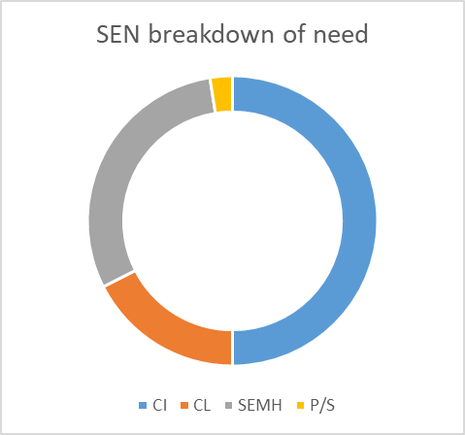
Our SEN profile for 2024/25
We currently have 40 children identified as having SEND, which is 8.70% of pupils, as compared to a
national average of 13.6%.
We currently have 14 children with an EHCP which is 3.04% of pupils, as compared to a national average of 4.8%.
50 % of Children are identified as having SEND
linked to communication and interaction.
17.5% of children are identified as having SEND
linked to cognition and learning.
30% of children are identified as having SEND
linked to Social, Emotional and Mental Health.
2.5 % of children are identified as having SEND
linked to physical and/or sensory needs,
NB: Some of our children have SEND needs across more than one area,
this has captured the children’s primary need.

Slide 8
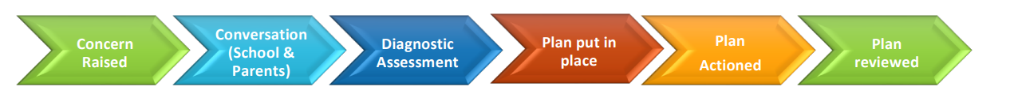
How we identify SEND need
At different times in their school career, a child may have a special educational need. The route to identifying a child’s SEN normally follows the below pattern:
Concern raised by parent/carer or class teacher or member of school staff
Conversation between school and parents/carers take place
Interventions/ additional support is put in place by school to support the child in making the desired progress.
Diagnostic assessment may take place which can include professionals external to the school such as an Educational Psychologist or Advisory Support Teacher. We may also suggest you make an appointment via your GP for a medical referral
A learning support plan for the child is developed with the child and their parent/carers
The plan is put into place and actioned
The plan and actions are reviewed regularly

Slide 9
If is child is identified as having SEN, we will provide them with provision that
is ‘additional to’ or ‘different from’ the differentiated curriculum to help them over
the barrier to their learning.
All children are unique and may need additional support for a variety of reasons: prolonged absence from school or have attended many schools, worry and anxiety causing a distraction from school or have English as an additional language (EAL). We are committed to ensure that all children have access to learning opportunities so they can fulfill their potential . For those at risk of not progressing it is the school's duty to intervene and provide support. This does not mean however that all vulnerable children have Special Educational Needs. Only those with a learning difficulty that requires provision which is ‘additional to or different from’ will be identified as having SEN.

Slide 10

SEN Support
The Assess Plan Do Review Cycle is completed 3 times a year as a minimum.
SEN support will be provided using a ‘graduated approach’. This approach will follow a four part cycle:
Identify/Assess- we consider all the information from discussions with parents/carers, the child, the class teacher and assessments (national curriculum,NFER, statutory)
Plan- now we can identify the barriers to learning and intended outcomes. We work out what additional support will be provided to help overcome these barriers. Decisions are recorded on a Learning Support Plan and are reviewed at least twice a year with parents/carers
Do- this is providing the agreed upon support as set out in the Learning Plan
Review- we measure the impact of support and consider if changes need to be made. All those involved - learner, parents/carers, teacher and SENDCo to contribute to the review. If necessary, a new cycle of Plan, Do, Review can begin

Slide 11
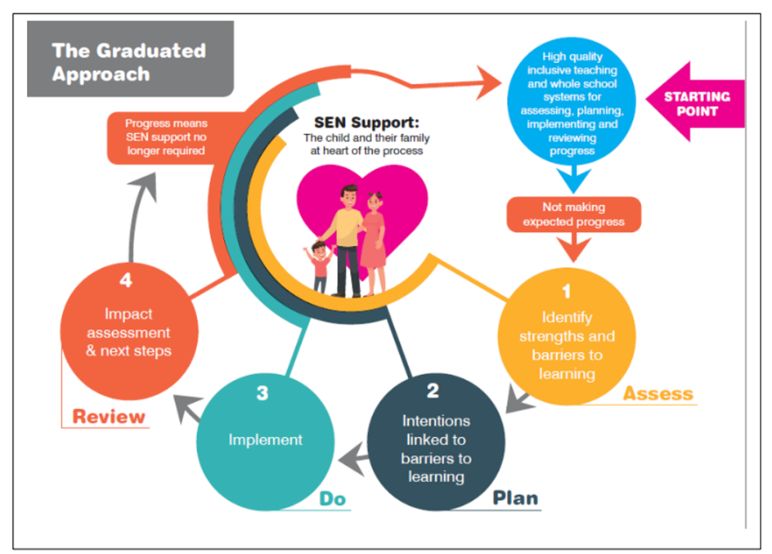

Slide 12
Requesting an EHC needs assessment - EHCP
‘The majority of children and young people with SEN or disabilities will have their needs met within local mainstream early years settings, schools or colleges. Some children and young people may require an EHC needs assessment in order for the local authority to decide whether it is necessary for it to make provision in accordance with an EHC plan.’ (SEN Code of Practice, 2015)
At Poringland Primary school, there are times when we may feel that despite taking ‘relevant and purposeful action’(SEN code of practice 2015), an EHC assessment request may be required.
The following people can request an EHC needs assessment for a child:
· the child’s parent
• a young person over the age of 16 but under the age of 25, and
• a person acting on behalf of a school or post-16 institution
( SEN code of practice 2015)
When a child has an EHCP an annual review is held.This takes account of the views of the child, parent/carer and professionals working with the child/young person.
More information regarding an EHCP can be found here:
https://www.norfolk.gov.uk/children-and-families/send-local-offer/education-and-learning/support-for-learning/education-health-and-care-ehc-plans

Slide 13
Support available to our children
Quality First Teaching Class Teachers Teaching Assistants | -The teacher will have the highest possible expectations for your child and all pupils in their class. -All teaching is based on building on what your child already knows, can do and can understand. -Putting into place different ways of teachings so that your child can fully access and engage in learning in class. -Your child will be in a mixed ability class for many subjects however some subjects are taught in ability groupings.
Support from our Mental Health Champion | Regular meetings to address and work on difficulties identified Referrals made to outside professionals where necessary and appropriate Signposting to support outside of school
Referral for additional Provision such as: Speech and Language Therapy, Occupational Therapy, Access Through Technology (ATT), Educational Psychologist | We work closely with EPSS, MHST,School and Communities team and other professionals to receive advice and additional support for pupils. We will always seek your consent and agreement before referring your child.

Slide 14
Specified support according to your child’s needs | - Small workshop groups with high ratios of adults to children - Intervention groups run in the afternoons focusing on a range of needs - Pets As Therapy Reading dog
Additional in-class support | - Additional in-class support is decided once the individual needs of children in given class groups have been considered. -Class groups at Poringland Primary School and Nursery are typically around 30 children.

Slide 15
Our approach to teaching Learners with SEND
Sensory and or Physical Needs
Possible barriers to Learning | Our Provision | Specific support/interventions
-Visual Impairment -Hearing Impairment -Gross/fine motor difficulties -Diagnosed conditions (dyspraxia) | -Quality first teaching -Additional adult support/scaffolding (teaching assistant) -Inclusive environment which values respect and diversity. -Disabled Toilets - Printed copies of board materials (and large print if required.) -Careful seating adjustments personalised to the child’s need. - Specialist Equipment; including pencil grips/overlays/sloping boards/ear defenders. - Calm spaces. -Working walls and displays in Readable font | - Dough Disco -Handwriting interventions -Sensory Circuits -Sensory Breaks tailored to individual (movement breaks/ ’heavy work’) - Care Plans -Support from outside agencies - Referrals to specialist services where required.

Slide 16
Our approach to teaching Learners with SEND
Social Emotional Mental Health
Possible barriers to Learning | Our Provision | Specific support/interventions
Low self esteem Anxiety/ withdrawn/isolated Behaviours that pose a risk to themselves or others Behaviours that can create barrier to learning. Diagnosed disorders such as ADHD Trauma Challenges with forming and maintaining friendships/relationships. | -Quality first teaching -Additional adult support/scaffolding (teaching assistant) -A nurturing school environment. -Clear classroom routines/ visual timetables. -A curriculum which support children’s health wellbeing and emotional literacy ( Paths and RSE). - E safety/anti bullying. - A whole school behaviour policy. -Norfolk steps approach to support managing behavoiur -Calm spaces. | 1-2-1 Nurture interventions ( Thrive) Weekly PAT dog sessions Behaviour support plans Classroom/tailored reward charts Norfolk steps referrals to specialist external agencies when required. MHST After lunch listening/support service for children in KS2 requiring support with lunchtime difficulties.

Slide 17
Our approach to teaching Learners with SEND
Communication and Interaction
Possible barriers to Learning | Our Provision | Specific support/interventions
Understanding language and using language Attention and Listening Stammering Conditions which can present social interaction difficulties eg (Autism Spectrum Disorder) Conditions including speech sound disorders. | -Quality first teaching -Additional adult support/scaffolding (teaching assistant) and model language -A range of visual aids including word mats/core boards and checklists. -Clear instructions and routines (Visual timetables) -Additional thinking time -Partner talk and lots of speech opportunities embedded within the curriculum. - Signalong in our Nursery | Wellcomm assessments Early Talkboost/Talkboost Referrals to Speech and Language professionals Personalised Interventions as instructed by Speech and language therapists Referrals to other specialist support

Slide 18
Our approach to teaching Learners with SEND
Cognition and Learning
Possible barriers to Learning | Our Provision | Specific support/interventions
Spelling and reading Diagnosed conditions such as dyslexia, dyscalculia Learning new information Organisation skills Concentration and focus Working Memory Number work | -Quality first teaching -Additional adult support/scaffolding (teaching assistant) -Adapted resources to scaffold individual /concrete resources available - Word mats,working walls ( with key vocabulary and learning, short clear instructions , visual prompts. - recap prior learning in all lessons. - Bespoke timetables when required to support movement breaks and extra time. | Nessy Sumdog Precision teaching FFT Phonics Lightening squad Pre and Post teaching Referral to specialist services. Coloured overlays where necessary Memory interventions

Slide 19
People who support our children
People who support our children in school | Their role and responsibilities
Class Teacher | Teaching and supporting your child on a day to day basis. Ensuring the wellbeing of all pupils in the class is nurtured and any concerns are discussed with parents and other members of staff where appropriate
Teaching Assistants | Supporting your children within class. Working with individual children and small groups under the planning and direction of class teacher. Ensuring the wellbeing of all pupils is nurtured and any concerns are discussed with the class teacher.
Children in our school will receive support that is specific to their individual needs. This will be provided by their class teacher in partnership with the SENDCo, other school staff, together with external support where necessary and appropriate.

Slide 20
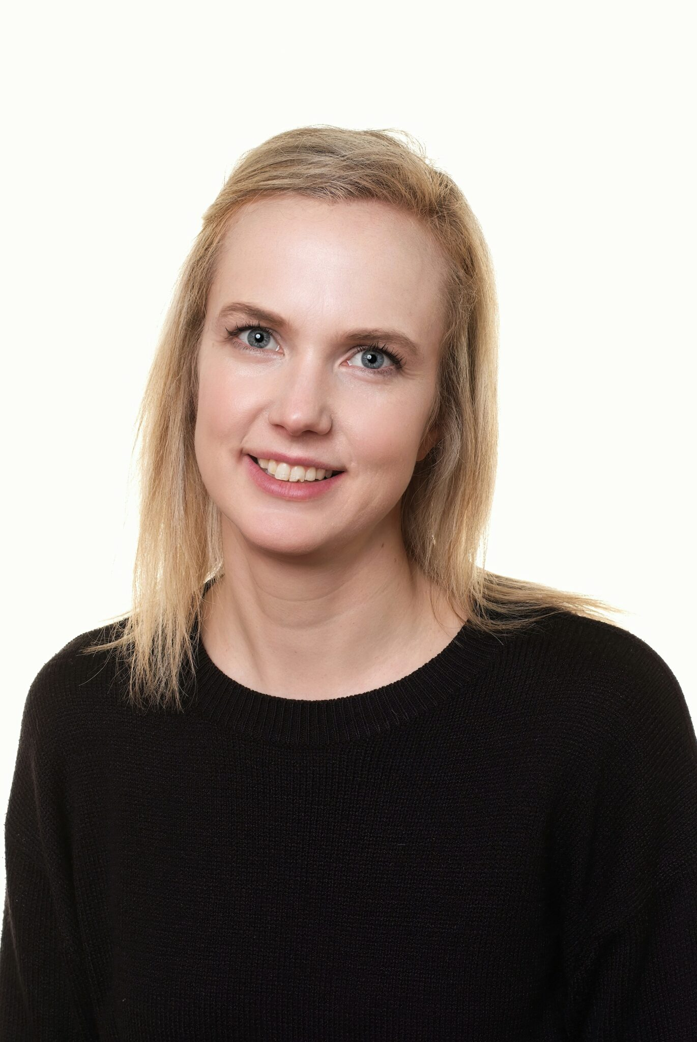
Special Educational Needs and Disabilities Coordinator (SENDCo) Emma Steward | -Ensuring that individual children are assessed to identify specific learning needs or barriers to learning. -Carrying out baseline assessment when children arrive at school and using this information to accurately identify areas of need. -Ensuring that all members of staff working with your child in school are aware of your child’s individual needs and/or conditions and what they need to enable them to learn and make progress. -Ensuring that all staff members are supported to deliver planned work/programmes for your child so they can achieve the best possible progress. This may involve input from external specialists. -Ensuring that you are: Listened to carefully and your concerns are taken seriously Involved in supporting your child’s learning Kept informed about the support your child is receiving Involved in reviewing your child’s progress and in the future planning process Signposted to external support where appropriate Leading and coordinating Annual Review Meetings. Liasing with all other professionals who may contribute to and support your child’s learning e.g. Educational Psychologist, Access Through Technology, Specialist teachers, Speech and Language therapists etc

Slide 21
Head Teacher Peter Dean | The day to day leadership and management of all aspects of the school. Ensuring that the Governing body is kept up to date about issues that arise in the school.
Year 6 Team | Gathering evidence of access arrangements requirements for statutory testing. Applying for access arrangements.
Governing Body | Ensuring that the school has an up to date SEN Policy Ensuring the school has appropriate provision and has made necessary adaptations to meet the needs of all children in the school. Making visits to understand and monitor the support given to children within the school Being part of the process to ensure your child reaches their potential

Slide 22
Parents | Attend Parents meeting twice a year with class teacher - and any additional meetings to discuss progress and next steps. Communicate with staff in person/telephone/school email or home learning platform Tapestry/Google classrooms. Meet with external agencies involved with supporting their child when necessary
Child | Contribute to their support plans through child voice to identify their strengths/difficulties and how school can support them. Take part when necessary in their EHCP review -sharing their views on how they are getting on in school. Take part in interventions/use resources to support them in their learning. Talk to adults in school about any worries/concerns they have.

Slide 23
Other support available to our children
As part of our Cluster of Schools, we have commissioned services from Norfolk County Council which gives us access and an allocation of hours to an Education Psychologist and a Specialist Learning Support Teacher.
Children will get support that is specific to their individual needs. This may be provided by their teacher, other staff or individuals who visit from outside agencies such as Speech and Language Therapists. Interventions are carefully co-ordinated and delivered throughout the school day to minimise impact on the classroom learning.

Slide 24
Supporting significant Transitions
Transition is a part of life for all our children. This can be transition to a new class in school, having a new teacher or moving on to a new school. Planning for transition is a part of our provision for all learners, especially those with SEN. We recognise that transitions can be a challenge for our children and we take steps to ensure that every transition is a smooth and positive experience by working in partnership with children, families and other providers.
Joining Poringland Primary School and Nursery:
The SENDCo/class teacher will liase with the current Early Years Provider or school
We will first invite you to visit the school to have a look around and speak to staff
Once we have your child’s place confirmed by Norfolk County Council we will invite your child to attend transition sessions in Reception. Enhanced transition is available for those needing greater familiarisation
We may visit your child at their primary school/Early Years Setting.
Moving class:
Moving classes will be discussed with you and your child towards the end of the summer term. During annual reviews, a teacher from the next class will be present.
Bespoke arrangements to support each child.
LInks to our virtual school to familiarise yourself with your class.

Slide 25

Supporting significant transitions
Moving to a different school: The SENDCo will liaise with the new school to discuss the plans in place to support your child. Documentation and reports from support agencies will be forwarded to the new school.
Moving up to high school: For those in Year 6 leaving Poringland Primary and Nursery, we will discuss a transition plan in partnership with the High School, you and your child. Our feeder High School Framingham Earl offer enhanced transition depending on the needs of the child in discussion with parents, often involving additional transition visits.
We use support from the school and communities team and Mental health support teams to arrange enhanced transition workshops for any child/young person requiring additional support.

Slide 26
What SEN training Opportunities have staff received?
Training recently completed by staff:
Wellcomm training
Dyslexia Training- Dyslexia friendly classrooms
Mental Health First Aid training
Step on training - refresher
Step up training - refresher
Sensory circuit Training
Understanding Autism training
Thrive practitioner training
Core communication champion training
Sendco Assistant currently undergoing - HLCP ( higher level communication training programme through ELKLAN).
Our Sendco is currently undergoing her NPQ sendco - with the Julian teaching Hub and also attends Sendco forum and is part of the essential Senco network which offers updates / advise and training opportunities.

Slide 27

How we support parents
At Poringland Primary School and Nursery, we regard it as essential to work in partnership with parents to achieve the best outcomes for their child. We offer the following support:
A Parent and Teacher Association (PTA)
An Open Door Policy – You are always welcome to call and make an appointment to meet any of our staff.
Termly coffee mornings – a chance to pop in and See our Sendco and make an appointment to discuss any concerns.
Additional meetings for SEND children.
Access to the Norfolk Local Offer- http://www.Norfolk.gov.uk/sen
Promoting a positive culture which encourages parents to speak to teachers/SLT when an problem or concern arises

Slide 28
Other support and available and useful information
The Local Authority has to have a Local Offer which sets out the support they expect to be available for children with SEN and/or disabilities. You can access the Local Offer here http://www.norfolk.gov.uk/children-and-families/send-local-offer
Norfolk SENDIASS offers independent information, advice and support to the children and their parents regarding SEN and disabilities. This is a free, confidential and impartial service. You can access the website here
Norfolk SENDIASS Home Page
Email: norfolksendiass@norfolk.gov.uk
Telephone: 01603 704070

Slide 29

The Local Offer
Poringland Primary’s Information Report forms part of Norfolk’s Local Offer.
Norfolk’s Local Offer
The special educational needs and/or disabilities (SEND) Local Offer is what is available in Norfolk for children and young people with SEND aged 0–25 and those who support them.
For more information about Norfolk’s local Offer, please visit
www.norfolk.gov.uk/children-and-families/send-local-offer
Useful guidance to support schools with the provision in place.
SEN Support Guidance Provision Expected at SEN Support (PEaSS) (norfolk.gov.uk)

Slide 30
Signposting and support for parents and Carers
Just One Norfolk
A support service for a range of services including emotional support and Speech and Language.
0300 300 0123
Health Advice & Support for Children & Families
Norfolk Early Help Services
Supporting families with any worries they may be having about their children and family circumstances.
Early help for children and families - Norfolk County Council
Ormiston Families
Suppporting families with a range of emotional wellbeing services( referrals made via just one Norfolk).
Ormiston Families | Brighter Futures | East of England Charity : Ormiston Families
NANSA - Norfolk and Norwich SEND association
Provides services for those living with SEND
Nansa
Family Voice Norfolk
Service working with parents and carers of children with SEND - ensuring parents voices are heard in decisions being made.
Parents and carers of children and young people with SEND – Family Voice Norfolk

Slide 31
Useful School Policies
SEND – Poringland Primary
Wellbeing – Poringland Primary
Safeguarding – Poringland Primary
Single Equality and Accessibility Policy Action Plan.docx
Complaint Procedure 2022.docx
For any other policies please go to our website -
Policies – Poringland Primary

Slide 32
Glossary
ADHD – Attention Deficit/Hyperactivity Disorder
APDR – Assess, Plan, Do and Review
ASD – Autism Spectrum Disorder
ATT – Access Through Technology
CI – Communication and Interaction
CL – Cognition and Leaning
EAL - English as an Additional language
EHCP – Education and Healthcare Plan
MHST - Mental Health Support Team
PAT - Pets as Therapy( Dog)
SALT – Speech and Language Therapy
SEMH – Social, Emotional and Mental Health
SEND – Special Educational Needs and Disabilities
SENDCO – Special Educational Needs and Disabilities Coordinator
S/P – Sensory and Physical

Slide 33
Have your say and how to contact us
The annual report sets out our annual offer to children with SEN but to help us to continually assess and improve we need the views of parents/carers, pupils, governors and staff. Therefore please engage with our annual process to ‘assess, plan, do, review’ provision for SEN.
If you have concerns about your child you should call or email the school or speak to your child’s class teacher.
If you are unhappy with how the concerns are being managed and/or think that your child is not making progress, you can speak to the SENDCO – Emma Steward or the Head Teacher- Pete Dean.
We would encourage you to contact us and ask for a meeting. If you still feel unhappy you can speak to the school chair of Governors-Jo Francis.
If we have concerns we will contact you to arrange a meeting in school.
Poringland Primary School and Nursery
Telephone number: 01508 492530
Email Address: office@poringland.norfolk.sch.uk

